Slide 1
2D Arrays in a Function
ELEC1006: ENGINEERING COMPUTING

Slide 2

2D Array Initialisation
Two-dimensional arrays are initialised row-by-row: const int ROWS = 2, COLS = 2; int exams[ROWS][COLS] = { {84, 78},
{92, 97} };
Can omit inner { }, some initial values in a row – array elements without initial values will be set to 0 or NULL
PAGE 2

Slide 3
2D Array as Argument & Parameter
Use array name as argument in function call:
getExams(exams, 2);
Use empty [] for row, size declarator for column in prototype, header: const int COLS = 2; // Prototype void getExams(int [][COLS], int); // Header void getExams(int exams[][COLS], int rows)
PAGE 3

Slide 4
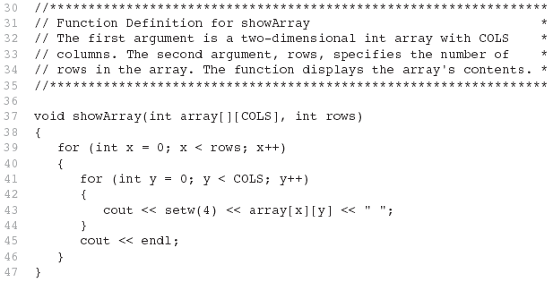
Example 1: The showArray Function
PAGE 4

Slide 5
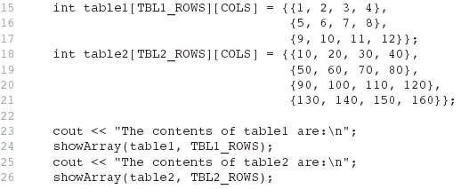
How showArray is Called
PAGE 5

Slide 6
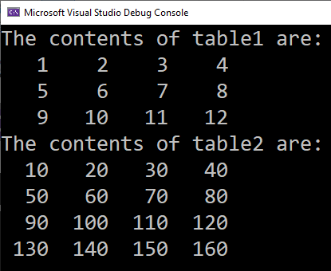
Example 1 Output
PAGE 6

Slide 7
More info
[1] cplusplus.com: Arrays
https://www.cplusplus.com/doc/tutorial/arrays/
[2] leanrcpp.com: 6.1 – Arrays (Part I) https://www.learncpp.com/cpp-tutorial/61-arrays-part-i/
[3] learncpp.com: 6.2 – Arrays (Part II)
https://www.learncpp.com/cpp-tutorial/62-arrays-part- ii/
[4] learncpp.com: 6.3 – Arrays and loops
https://www.learncpp.com/cpp-tutorial/63-arrays-and- loops/
PAGE 7

